Slide 1
2023-2024 ATE
Teaching Dossier Workshop
Questions?
Contact the 2023-24 Chair of the Academy of Teaching Excellence:
Jessica Folkart (jfolkart@vt.edu)

Slide 2
ATE Website
ATE webpage with key links: https://teaching.vt.edu/grantsandawards/awards/ate.html
This Powerpoint slide show and a recording of this Zoom presentation will be posted on the ATE dossier guidelines page: https://teaching.vt.edu/grantsandawards/awards/ate/ate-dossier-guidelines.html

Slide 3
NOTE: The Diggs Award is not managed by the ATE.

Slide 4
Dossier Contents
Limit total length to 11 pages (excluding cover page and SPOT information appendix)
Cover Page (Download Template)
Section 1:Distinctive Contributions and Achievements Ann Stevens
Section 2: Nomination Letter Gena Chandler
Section 3: Teaching Statement David Schmale
Section 4: Letters of Recommendation and/or Peer Evaluations of Teaching Jessica Folkart
Section 5: Additional Documentation David Schmale
REQUIRED APPENDIX: SPOT Information Ann Stevens
***********
Alumni Teaching Award Excellence Rubric: Ann Stevens

Slide 5
SECTION 1: Distinctive Contributions & Achievements
one page
Provide a bulleted list of:
Significant teaching accomplishments at VT (undergraduate and graduate students)
Awards
Grants
Scholarship
Educational outreach
Activities demonstrating the nominee’s commitment to excellence in teaching and student learning
See examples for suggested headings!

Slide 6
Distinctive Contributions and Achievements
Classroom Excellence
2011 | CERTIFICATE OF TEACHING EXCELLENCE, College of Architecture & Urban Studies 2011 | FAVORITE FACULTY NOMINATION, Virginia Tech, Office of Residence Life
2010 | MOST ADMIRED DESIGN EDUCATOR (1 of 25 chosen from all design educators— architecture, landscape architecture, interior design and industrial design—from the U.S. and Canada), by Design Intelligence
2010 | THANK A TEACHER RECOGNITION, Virginia Tech, CIDER
2009 | TEACHING EXCELLENCE AWARD College of Architecture & Urban Studies, Virginia Tech 2008 | NEW FACULTY TEACHING AWARD, School of Architecture + Design, Virginia Tech
2003 | TEACHING EXCELLENCE AWARD, Pan-Hellenic Council, Virginia Tech
Average Student Evaluation (SPOI Item 7) of 3.85 for all courses at Virginia Tech—during period department average was 3.46 in similar courses
Most
recent
Least
recent
Headings:
use headings related to nomination text
range of headings reveal the range of contributions
Dates in each section by reverse chronology
Selected Teaching Contributions through Undergraduate Curriculum Innovation Undergraduate Interior Design Program Ranked 6th in North America, 2012 (of 350+ programs) Have taught 16 different courses at Virginia Tech
Created first and only online course for the School of Architecture + Design (ITDS 4114) Created 5 special topics courses 4XXX since 2007
Led the Accreditation effort in 2011, wrote pre-visit report, set up exhibit and hosted site visitors
Selected Teaching Contributions through Graduate Curriculum Creation and Innovation
Graduate Program Ranked in the top ten in North America (2008-2010)
Re-started the Graduate Program for interior design within the School of Architecture + Design
Created and taught both Advanced Design Labs, the Design Theory and Research class, and the Project and Report for the Graduate Program in interior design
Enhancing Student Educational Environment
Have written three textbooks for interior design education: Building Systems and Construction for Designers (2010—adopted at 37 institutions in the US and Canada); Designing for Cradle to Cradle with Anna Marshall-Baker UNCG (2012—adopted at 5 institutions); and Designing Commercial Interiors: Sustainable Concepts and Practices (2013--in press)
Education Grants to Enhance Teaching and Learning
2013 | Provost Grant for Online Course Development for ITDS 4114 ($3911)
2009 | ICTAS Grant with CPES--engineering and interior design students ($189,000)—one of four researchers (2009-2011)
2008 | Nuckolls Grant for an Introductory Lighting Program at Virginia Tech—created relevant
courses and solicited fixtures for and installed a new lighting lab ($20,000, 2008-2012) 2002 | CEUT Grant for Building Systems for Interiors, ITDS 3175-3176 ($4900)
Teaching Service and Outreach
Chair, Diversity Committee (20011-present); Honorifics Committee (2007-2012); Chair Search Committee (2 positions) 2012; Chair, interior design program (2012-present); Chair, graduate program (2008-present); member Peer Review Committee (2011-12); Curriculum committee (2012-present)

Slide 7
Distinctive Contributions and Achievements
Classroom Excellence
2011 | CERTIFICATE OF TEACHING EXCELLENCE, College of Architecture & Urban Studies 2011 | FAVORITE FACULTY NOMINATION, Virginia Tech, Office of Residence Life
2010 | MOST ADMIRED DESIGN EDUCATOR (1 of 25 chosen from all design educators— architecture, landscape architecture, interior design and industrial design—from the U.S. and Canada), by Design Intelligence
2010 | THANK A TEACHER RECOGNITION, Virginia Tech, CIDER
2009 | TEACHING EXCELLENCE AWARD College of Architecture & Urban Studies, Virginia Tech 2008 | NEW FACULTY TEACHING AWARD, School of Architecture + Design, Virginia Tech
2003 | TEACHING EXCELLENCE AWARD, Pan-Hellenic Council, Virginia Tech
Average Student Evaluation (SPOI Item 7) of 3.85 for all courses at Virginia Tech—during period department average was 3.46 in similar courses
Most
impact
Prioritize presentation of achievements and contributions; start to “build a story”
Selected Teaching Contributions through Undergraduate Curriculum Innovation Undergraduate Interior Design Program Ranked 6th in North America, 2012 (of 350+ programs) Have taught 16 different courses at Virginia Tech
Created first and only online course for the School of Architecture + Design (ITDS 4114) Created 5 special topics courses 4XXX since 2007
Led the Accreditation effort in 2011, wrote pre-visit report, set up exhibit and hosted site visitors
Selected Teaching Contributions through Graduate Curriculum Creation and Innovation
Graduate Program Ranked in the top ten in North America (2008-2010)
Re-started the Graduate Program for interior design within the School of Architecture + Design
Created and taught both Advanced Design Labs, the Design Theory and Research class, and the Project and Report for the Graduate Program in interior design
Enhancing Student Educational Environment
Have written three textbooks for interior design education: Building Systems and Construction for Designers (2010—adopted at 37 institutions in the US and Canada); Designing for Cradle to Cradle with Anna Marshall-Baker UNCG (2012—adopted at 5 institutions); and Designing Commercial Interiors: Sustainable Concepts and Practices (2013--in press)
Education Grants to Enhance Teaching and Learning
2013 | Provost Grant for Online Course Development for ITDS 4114 ($3911)
2009 | ICTAS Grant with CPES--engineering and interior design students ($189,000)—one of four researchers (2009-2011)
2008 | Nuckolls Grant for an Introductory Lighting Program at Virginia Tech—created relevant
courses and solicited fixtures for and installed a new lighting lab ($20,000, 2008-2012) 2002 | CEUT Grant for Building Systems for Interiors, ITDS 3175-3176 ($4900)
Least
impact
Teaching Service and Outreach
Chair, Diversity Committee (20011-present); Honorifics Committee (2007-2012); Chair Search Committee (2 positions) 2012; Chair, interior design program (2012-present); Chair, graduate program (2008-present); member Peer Review Committee (2011-12); Curriculum committee (2012-present)

Slide 8
01
Honors and Awards Recognizing Excellence in Teaching and Learning
2013, Council of Educators in Landscape Architecture, Excellence in Teaching Award (international).
2013, University Certificate of Teaching Excellence.
2011, College of Architecture and Urban Studies Teaching Excellence Award.
2010, Certificate of Appreciation from US Mission to the United Nations (developed and implemented a competitive program for American landscape architecture students).
2010, College of Architecture and Urban Studies Excellence in Outreach Award (coordinated on-site construction by landscape architecture students at the 2006 VT Solar House in Washington DC).
Pedagogical and Curricular Contributions to the Graduate & Undergraduate Teaching Mission
Developed and taught 21+ new and revised courses (2 with others) to address changing disciplinary expectations in community engagement, professional competencies, communication and critical thinking skills, and contemporary research areas.
Advise masters and PhD students in Blacksburg and at the Washington-Alexandria Architecture Center (WAAC), and senior thesis students in Blacksburg.
Regularly mentor undergraduate and graduate independent studies each semester.
Develop and lead annual interdisciplinary education abroad program through Europe (10+ yrs)
Develop and lead annual community engagement teaching-learning programs both in and outside of normal curricula offerings, including interdisciplinary and honors course offerings (15+ yrs).
Scholarship of Teaching and Learning (SoTL)
3 papers published and 9 conference presentations in SoTL; 12+ papers & presentations co-authored with students; 25+ public and community exhibitions of student work.
Education Grants Funded
CEUT/UOIP International Faculty Fellow. Developed a VT image database for teaching & learning.
USDA Higher Education Grant (6 US universities). Developed an on-line image database for teaching.
Teaching-related Service and Outreach
Department and School: UG academic advisor, advisor & coordinator of 4th year studio option, advisor to ASLA-VT (student professional organization), coordinator of senior projects and competition for best senior project, peer review and faculty search committees, UG curriculum committee (former chair), graduate curriculum committee (former chair).
Use full titles before relying on acronyms.
Use action verbs and numbers

Slide 9
Honors and Awards Recognizing and Supporting Excellence in Teaching and Learning
Certificate of Teaching Excellence, College of Arts and Sciences – 2001 & 2013
Program of Excellence Award from the Basic Course Division of the National Communication Association; courses designed by nominee – 2012
Awards from Communication Centers Section of National Communication Association for work in support of students’ oral communication: Service Award (recipient twice); Preston Leadership Award named for nominee and awarded annually at national conference
Indicate personal responsibility for activities; recognized shared contributions
Pedagogical and Curricular Innovations to the Undergraduate Teaching Mission
Designed, implemented and currently direct Communication Skills I&II (COMM 1015-16)
Designed, implemented, and currently direct CommLab, a speaking center for students across disciplines, housed in Newman Library
Designed, implemented, and directed hybrid model for Public Speaking (COMM 2004)
Designed and implemented online model of Interpersonal Communication (COMM 3124)
Designed and implemented Group Processes and Presentation (COMM 3164)--1-credit co- requisite course
Pedagogical and Curricular Innovations--Faculty Development and Graduate Teaching
Designed and implemented GTA training program, including Orientation and seminars
Designed and implemented COMM Pedagogy course for graduate students
Designed and implemented numerous faculty development programs for faculty across campus, including week-long Summer Writing Workshops, GTA Seminars, and workshops for CEUT, University Writing Program, FDI, Graduate School Orientation, and Assessment
As chair of UCCLE, designed and hosted two-part Symposium on General Education, 2010; invited guest speaker from AAC&U; 80 faculty participated.
Scholarship of Teaching and Learning – all scholarship related to T&L
1 chapter, 8 papers, 49 conference/invited presentations, 2 course manuals
Teaching-related Service and Outreach, including Assessment
Department service: Curriculum Committee, chair
College service: Curriculum Committee member (5 years), chair (2 years)
University service: UCCLE member and past chair (7 years); Common Book Committee (5 years); Diversity Committees – task force and working group (4 years)
Office of Academic Assessment Advisory Committee (2 years)
Directed or co-directed university assessments for SCHEV (4 years)
Use course names related to SPOT information
Include activities both internal and
external to VT
Keep content brief, there is an opportunity to
expand on items later in the dossier!

Slide 10
Section 2. Nomination Letter (2 pages)
“...should describe the nominee's extraordinary success in teaching at Virginia Tech by providing a narrative of the nominee's background, teaching experiences, pedagogical approaches, scholarship of teaching and learning, special contributions to student learning, other education-related awards, and any additional evidence of the nominee's exceptional achievements in promoting effective student learning.”

Slide 11
Narrative (n.)
a statement of alleged or relevant facts closely connected with the matter or purpose of the document (Scot. law)
An account of a series of events, facts, etc., given in order and with the establishing of connections between them; e.g., a story, an account
The strongest nomination letters will craft a convincing
narrative of the candidate.

Slide 12
SECTION 2. Nomination Letter (2 pages)
The nomination letter
provides context
is a chance to tell the story of nominee and why nominee is deserving of recognition
provides a roadmap for the rest of the dossier that follows, highlighting key themes and elements
reflects the depth and/or impact of the candidate’s teaching portfolio in the classroom and beyond; gives “scope”

Slide 13
Strong nomination letters should
Document specific accomplishments, not platitudes and generalizations
Guidelines speak of documenting “extraordinary success in teaching” and “evidence of the nominee's exceptional achievements in promoting effective student learning”
Demonstrate impact of candidate’s teaching excellence by referencing
students/alumni: solicited or unsolicited letters, emails, written evaluations, SPOT comments
department: curriculum development, teaching-related committee work, peer reviews of teaching, mentoring of colleagues
university: workshops given, curriculum development, teaching-related committee work, awards
profession: conference presentations, grants, publications (textbooks and scholarship of teaching and learning), awards

Slide 14
3. Reinforce the ideas, promises, self-portrait the candidate constructs in their teaching statement using
alumni/student comments and letters
peer teaching reviews
teaching philosophy
collaborators
4. Include nominator’s own firsthand testimony, if available
Provide a bit of background (context) about the candidate but focus on teaching and learning
5. Refer directly to the award criteria

Slide 15
Who should write and sign the nomination letter?
Usually the department chair, head of the honorifics committee, or senior colleague (varies across departments) writes the letter.
The nominee can help draft the letter and/or review it for accuracy, but the identity of solicited letter writers should be kept confidential.
Find out the practice in your department

Slide 16
Creating an Effective Narrative

Slide 17
On behalf of the Department of _________, I am pleased to nominate Dr. ___________________ for the W. E. Wine Award, which recognizes "a history of university teaching excellence." As this letter will show, Dr. ____________ has established a long, outstanding record of instructional excellence, from classroom teaching to work on curricular committees, to directing our graduate programs. She is more than deserving of the recognition the Wine Award bestows.
*Sets the stage for the narrative and the roadmap which will follow.

Slide 18
Primarily because of her expertise in Postcolonial and African-American literature, Dr.________________ has been obliged to develop an effective set of strategies for helping students deal with sensitive and controversial materials. As she says in her teaching statement, “Teaching reflects my career commitment to creating a classroom that transforms hostilities into mutual respect, understanding, and voice.” How is this formidable problem accomplished? She explains that " I build my courses on respect for students’ intellectual depth and time, but most importantly, on my trust of students and a belief that all students have the willingness and ability to thoughtfully and critically engage the deeply personal, often controversial, and ideologically challenging discussions my courses inevitably provoke." This confidence in her students is one of Dr. __________’s most striking characteristics as a teacher.
*Provides context, reinforces teaching philosophy, grounds the reader in a portrait of the nominee and characteristics of excellence in teaching

Slide 19
Her extraordinary commitment to and effectiveness in the classroom are evident to all. In her first two years with us, she taught seven different courses, which in retrospect seems almost criminal. This aspect of her teaching record has continued until today; she has quite probably
taught more different courses than any other faculty member in our department. Most faculty teach 3 or 4 different courses, but few teach more than that. This aspect of Dr. ____________’s teaching record points to both her range and her generosity…
*Again, note the ways the nominator creates a clear narrative; giving a portrait of the candidate, providing specific examples, outlining key strengths and indicators of “exemplariness” – starting at the beginning of candidate’s teaching career in this portion of the letter.

Slide 20
In Fall 2019, for example, I had to go on leave for the semester; I was scheduled to teach a senior seminar in Toni Morrison… as the only other African-Americanist in the department, Dr. ____________ agreed to teach the seminar, even though she had not taught a great deal of Morrison….The students rated her overall effectiveness a 6, and their comments range from "Dr. ____________ is the best lecturer I have ever had class with" to "This has been my favorite class ever." The consistent hallmark of Dr. ______________’s teaching is clearly reflected in this example: not only is she willing to teach whatever the department needs her to teach, but she does so with as great an effectiveness as is evident in classes close to her heart. Such teaching is extremely rare.
*Provides context, examples, maintaining the established narrative, moving reader’s through the candidate’s “career teaching excellence” and qualities
“Extraordinary commitment to and effectiveness in the classroom”
“Range and generosity”

Slide 21
In the SPOT comments…, students spoke to the way Dr. ____________ contextualized the literature they were reading...One student stated that the contextual information provided "REALLY helped situate Morrison’s work and my own understandings." Another student observed that "The writings and discussion both helped me think more critically about what we were reading. The discussions were helpful, engaging, and [I] always felt like I was learning something new or thinking about things in a new light."
*Incorporates student, peer assessment across time showing a pattern of excellence, too.

Slide 22
Continued…
Comments from former students are equally laudatory, but also bear the thoughtful and reflective quality given by a distance of time. Mr. _______(2011), who…received the CLAHS Outstanding Recent Undergraduate Alumnus Award, shares a memory from a specific class,
where he struggled to understand Salman Rushdie's East, West: Stories. He emailed Dr. ____________ after class, and she responded with "1200 words laying out what she could tell I understood about the text but did not have the tools to articulate yet. . . .I still re-read that email once every year or two and reflect on it one of many instances where she went above and beyond
the lecture to fostering creative and critical thought."
*Incorporates student, peer assessment across time showing a pattern of excellence. Letter writer here shows teaching excellence and student satisfaction from 2004-2021.

Slide 23
Dr. _________________not only opens her students to the challenges and the riches of African-American literature, but she also has been a tireless worker on curriculum committees to help develop a more inclusive curriculum. Her commitment has been evident in the numerous
curricular committees on which she has served.
*Writer continues to hold the line of the narrative and reflects what the dossier promises.
“...a long, outstanding record of instructional excellence, from classroom teaching to work on curricular committees, to directing our graduate programs.”

Slide 24
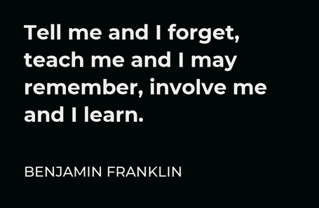
SECTION 3: Teaching Statement (1 page)
Your concept of the purpose and value of teaching and learning
Self-reflective exercise to enhance one’s ability to teach

Slide 25
SECTION 3: Teaching Statement (1 page)
Provide an engaging, reflective narrative of your beliefs about teaching and learning and how you put these beliefs into practice.
A teaching statement is a unique statement conveying your educational values, objectives, methods, approach and/or expertise. It illustrates how you concretely enact your core values to promote learning.
Your statement should demonstrate that you are both reflective and purposeful about teaching and learning and that you have translated these values into goals and goals into actions that have had a positive impact on student learning.

Slide 26
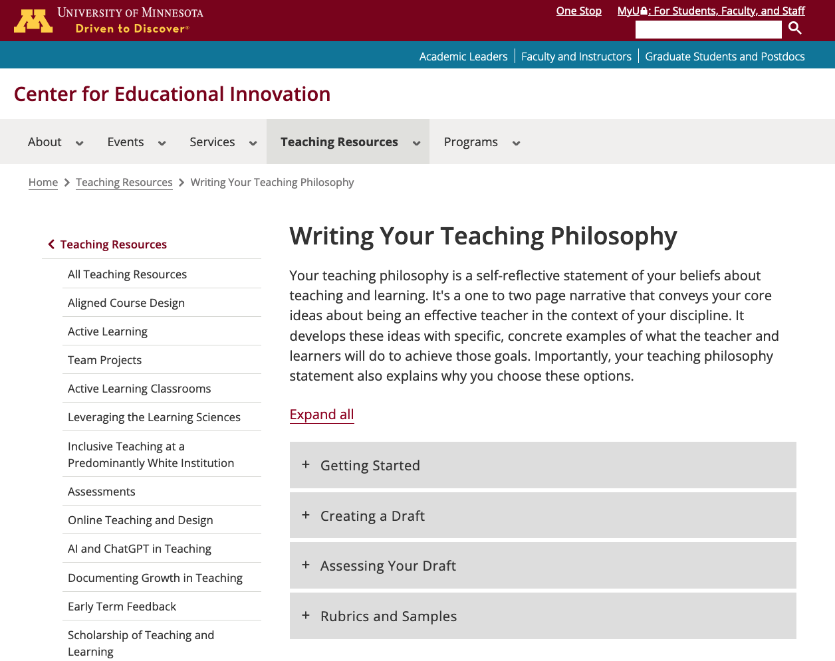
SECTION 3: Teaching Statement (1 page)
A source for guidance and inspiration:
University of Minnesota Center for Teaching and Learning: Getting Started on a Teaching Philosophy Statement

Slide 27
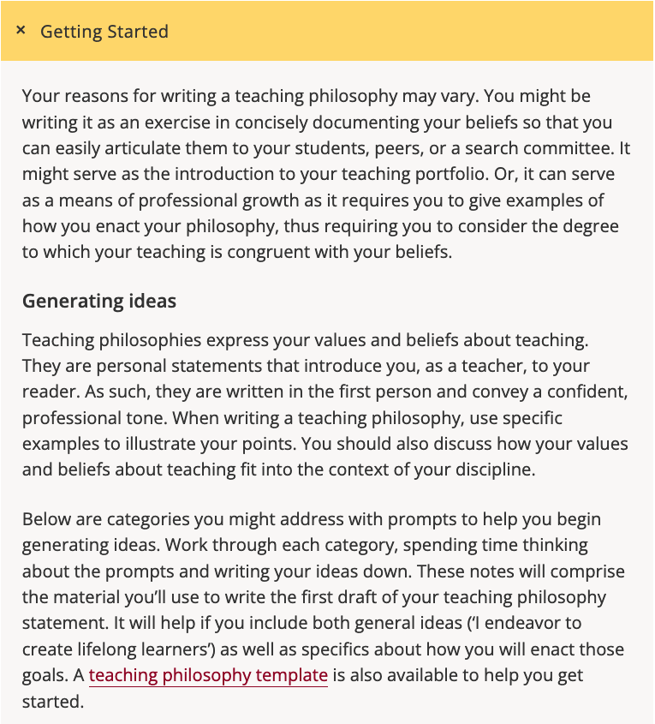
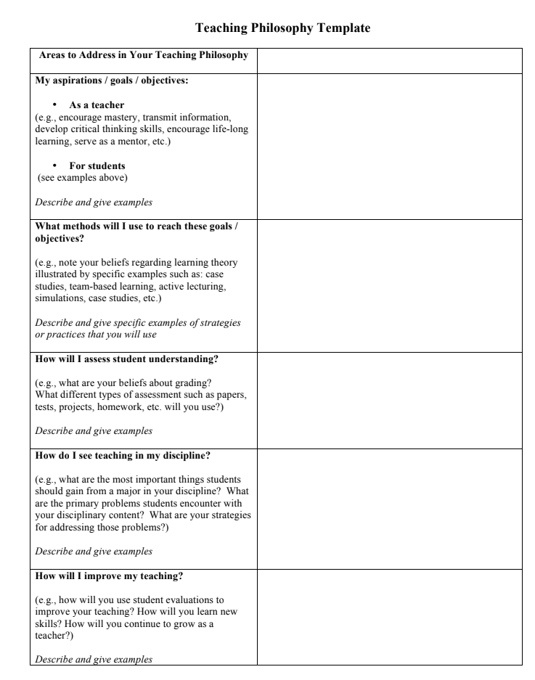
SECTION 3: Teaching Statement (1 page)
A source for guidance and inspiration:
University of Minnesota Center for Teaching and Learning: Getting Started on a Teaching Philosophy Statement

Slide 28
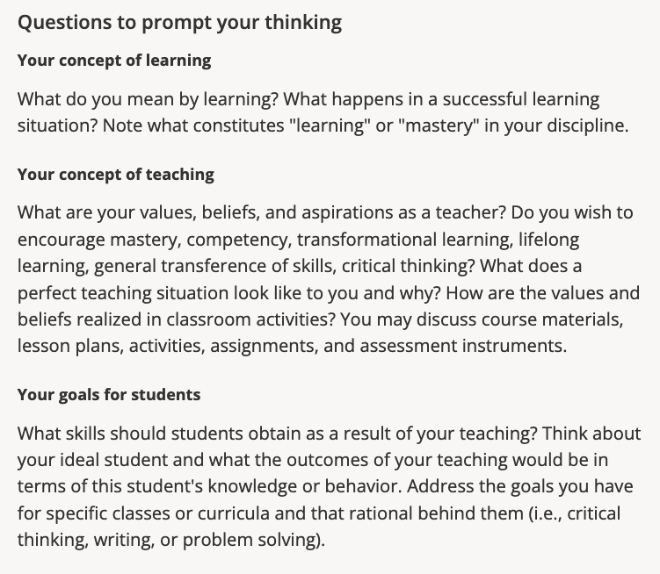
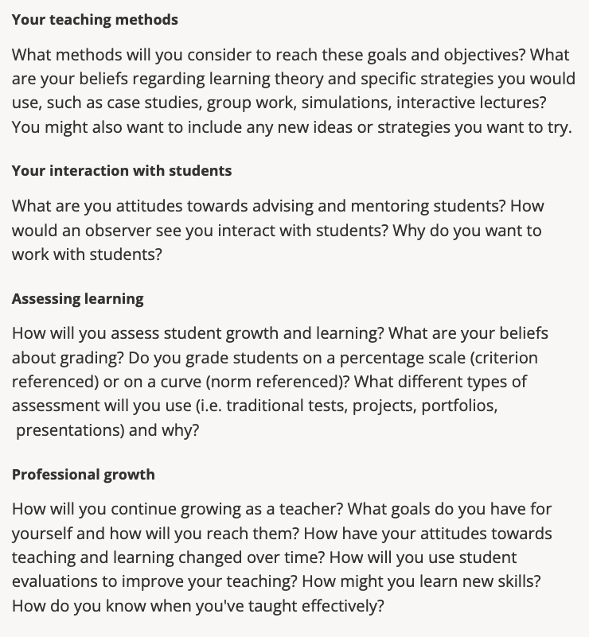
SECTION 3: Teaching Statement (1 page)
A source for guidance and inspiration:
University of Minnesota Center for Teaching and Learning: Getting Started on a Teaching Philosophy Statement

Slide 29
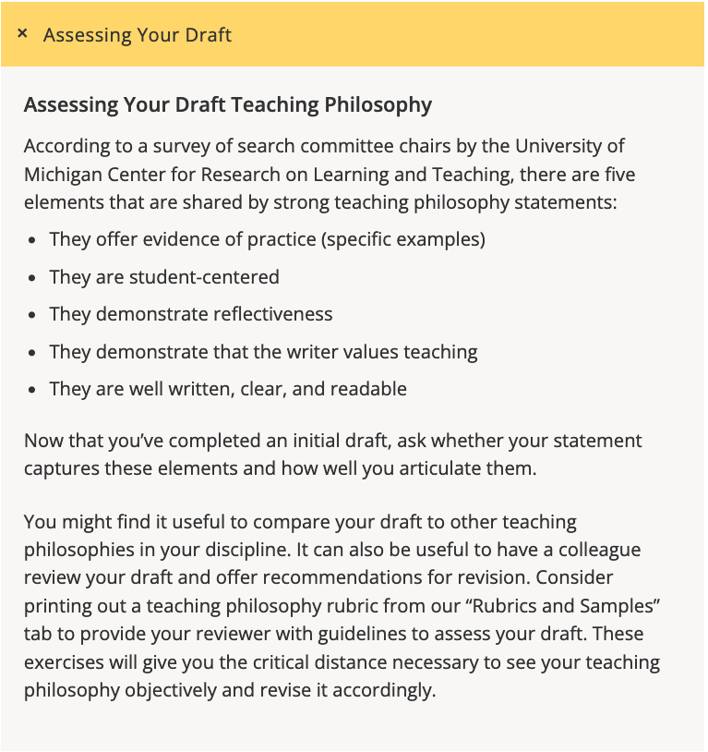
SECTION 3: Teaching Statement (1 page)
A source for guidance and inspiration:
University of Minnesota Center for Teaching and Learning: Getting Started on a Teaching Philosophy Statement

Slide 30
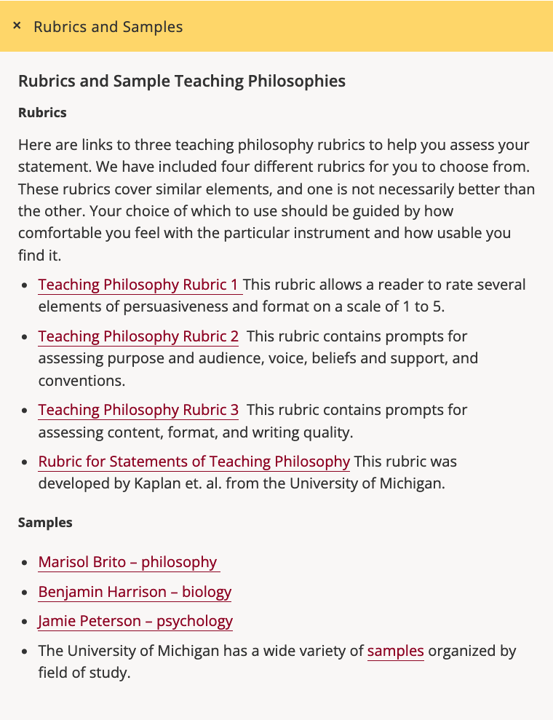
SECTION 3: Teaching Statement (1 page)
A source for guidance and inspiration:
University of Minnesota Center for Teaching and Learning: Getting Started on a Teaching Philosophy Statement

Slide 31
SECTION 4: Letters of Recommendation and/or Peer Evaluations of Teaching (4 to 5 one-page letters suggested).
Letters should demonstrate the breadth of the nominee’s impact on teaching and learning. Address a variety of classes, strengths, etc.
Formal one-page letters of support from former and current VT students should be requested by the nominator (as described above, i.e., dept. head, honorifics chair or senior faculty colleague) and kept confidential.
The nominee may provide a list of student names for the nominator to contact. It should be noted that letters from the nominee's former students (alumni) are particularly impactful.
If the nominee does not have someone to acquire letters on their behalf, they should contact the chair of the ATE.
Other letters can include those from the nominee's colleagues who are directly familiar with the nominee’s teaching or the impact or outcomes of their teaching (including peer evaluations), and/or from anyone qualified to comment on the nominee's extraordinary instructional impact.
A maximum of up to one page of unsolicited transcribed student quotes from personal correspondence including Email, a more formal letter or “thank a teacher” note with the nominee may be included, if desired.

Slide 32
SECTION 5: Additional Documentation (flexible, keeping within page limits for the dossier).
Submit evidence to document the nominee's extraordinary teaching successes at Virginia Tech; however, do not include links to external sites. This is your space to personalize/customize your package. Use all the space available!
Additional documentation will vary greatly, but may include:
details about course design & development and its impact on student learning
curriculum revision and its impact on student learning, retention, etc.
pedagogical innovations and their impact on student learning
student mentoring or advising activities
educational/pedagogical publications or presentations authored
teaching and learning workshops presented
educational grants received
educational outreach and service activities
peer evaluation of teaching letters (if not included previously), and
any other documentation of effective teaching and learning.
***Unsolicited student quotes or additional solicited student letters of recommendation should not be included in this section.

Slide 33
Required appendix of additional supporting documentation:
Student Perception of Teaching (SPOT) scores table (all electronic SPOT scores since 2011 (Wine Award), the past seven years (Alumni Award), or the past seven years or less depending on time of service (Sporn Award).
Use the linked template to organize scores for students’ perceptions of your teaching as reported on the university’s electronic SPOT form.
We recommend grouping like classes together in chronological order. Indicate the departmental average SPOT scores exactly as reported on the university’s electronic SPOT form.
Reduced teaching loads (sabbaticals, buy-outs, etc.) should be clearly indicated and explained through footnotes.
Any classes not evaluated also should be noted in the table (e.g., due to the impacts of COVID)
Instructors may locate their electronic SPOT forms in Canvas by going to their personal “Account” then “Files” then “Eval Reports”.

Slide 34
Required appendix of additional supporting documentation (continued):
Excel form is available for download on ATE site
SPOT scores post-2011 revision
6.0 scale
Reduced Teaching Load 2004/05. Pre-tenure Research Leave spring 2009
Attach a complete PDF file of one electronic SPOT, including all student comments for one course taught at Virginia Tech within the past three years.
The number of pages of this appendix section will vary, and it will not count as part of the 11 pages.

Slide 35
2020-2021 Alumni Teaching Award Excellence Rubric
Discuss/evaluate dossiers according to four teaching excellence focus areas (left column). Detailed descriptions of each of the four focus areas are shown in the gray boxes in Italics that span the middle columns.
Teaching excellence focus areas | Pertinent sections of the dossier | Excellent Evidence – 3 | Very Good Evidence – 2 | Good Evidence – 1 | No Evidence - 0
Evidence of effective student learning | Contributions and achievements Nomination letter Teaching statement SPOT/SPOI scores Letters of recommendation Additional documentation Appendix | Dossier includes compelling evidence that students are learning effectively as a direct result of the pedagogies employed by the candidate. Evidence of learning can include: 1) SPOT/SPOI scores that exceed departmental averages, 2) exemplary student and faculty comments that directly relate candidate's pedagogy to extraordinary student products such as student publications, design projects, and/or other products above and beyond the course or program, 3) letters of recommendation that demonstrate learning in the candidate's class, lab, or other venue with significant professional success, 4) any other lines of evidence that document student learning outcomes.
 |  | Dossier includes many lines of independent evidence that students are learning effectively as a direct result of the pedagogies employed by the candidate. | Dossier includes several lines of independent evidence that students are learning effectively as a direct result of the pedagogies employed by the candidate. | Dossier includes a few lines of independent evidence that students are learning effectively as a direct result of the pedagogies employed by the candidate. | No evidence
Evidence of exemplary course/curriculum design | Contributions and achievements Nomination letter Teaching statement Letters of recommendation Additional documentation | Dossier presents clear evidence of exemplary course and/or curriculum design incorporating pedagogical practices that manifest the candidate’s beliefs about learning. This evidence may include: 1) descriptions of course design project/s that successfully support a learning-centered classroom, workshop, or laboratory environment, 2) descriptions of curriculum design project/s that focus on student learning over multiple courses, 3) active participation in teaching and learning committees, including curriculum committees.
 |  | Dossier presents clear evidence that the candidate has actively and successfully contributed to several course/curriculum design projects or at several levels of course/curriculum design. | Dossier presents clear evidence that the candidate has actively and successfully contributed to at least two course/curriculum design projects or in at least two levels of course/curriculum design. | Dossier presents clear evidence that the candidate has actively and successfully contributed to at least one course/curriculum design project or in at least one level of course/curriculum design. | No evidence
Evidence of professional development and impact across the University | Contributions and achievements Nomination letter Teaching statement Letters of recommendation Additional documentation | Dossier includes examples of professional development, service, and/or campus/community outreach documented over time. Evidence of professional development can include: 1) advising and mentoring (undergraduate and graduate), 2) service on departmental, collegiate, or university level teaching and learning committees, 3) attendance at CIDER, FDI or other professional development opportunities (beyond what is required for computer receipt), 4) presentation of workshops on pedagogy, assessment, or some other facet of teaching and learning to other faculty at VT.
 |  | Dossier includes many examples of professional development, service, and/or campus/community outreach documented over time. | Dossier includes several examples of professional development, service, and/or campus/community outreach documented over time. | Dossier includes a few examples of professional development, service, and/or campus/ community outreach documented over time. | No evidence
Evidence of broader teaching impact beyond Virginia Tech | Contributions and achievements Nomination letter Additional documentation | Dossier includes examples documentating that the candidate has shared his/her pedagogical innovations, course/curriculum design, and success publicly beyond the VT campus. Evidence of this can include: 1) the publication of articles or abstracts or the distribution of white papers, 2) presenting at (or attending) education-related regional or national conferences, 3) presenting at (or attending) education-related regional or national workshops and seminars, or 4) any other activity that demonstrates that the candidate is actively sharing his/her teaching and learning accomplishments broadly and repeatedly beyond the VT campus. The candidate may also have received sponsored support to conduct research on learning, although obtaining outside funding is not an essential criterion of "mastery."
 |  | Dossier includes many examples documentating that the candidate has shared his/her pedagogical innovations and success publicly beyond the VT campus. | Dossier includes several examples documentating that the candidate has shared his/her pedagogical innovations and success publicly beyond the VT campus. | Dossier includes a few examples documentating that the candidate has shared his/her pedagogical innovation and success publicly beyond the VT campus. | No evidence

Slide 36
ATE Website
ATE webpage with key links: https://teaching.vt.edu/grantsandawards/awards/ate.html
This Powerpoint slide show and a recording of this Zoom presentation will be posted on the ATE dossier guidelines page: https://teaching.vt.edu/grantsandawards/awards/ate/ate-dossier-guidelines.html

